Slide 1
Clouds
9-3 to 9-5

Slide 2
Clouds
Clouds are classified by their shapes, elevation, and their associated weather conditions and patterns.
Clouds that form from the condensation of water vapor are classified by a basic shape and associated weather conditions and patterns. Clouds can be classified in three major groups: cirrus, cumulus, stratus
Types of Clouds Video 3:19
Clouds and Forecasting Video 2:01
MENU

Slide 3
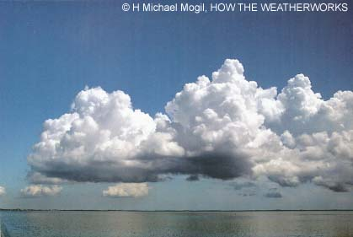
Clouds
Cumulus
· Clouds formed at medium or low elevation.
· Cumulus clouds are puffy with flat bottoms.
· When cumulus clouds are white they often signal fair weather, but when they are darker, they may signal rain or thunderstorms.
MENU

Slide 4
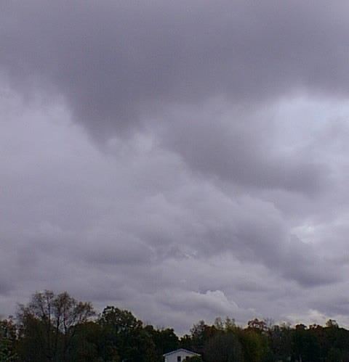
Clouds
Stratus
Clouds formed at medium or low elevation; spread out layer upon layer covering a large area
As stratus clouds thicken, precipitation usually occurs over that area.
MENU

Slide 5
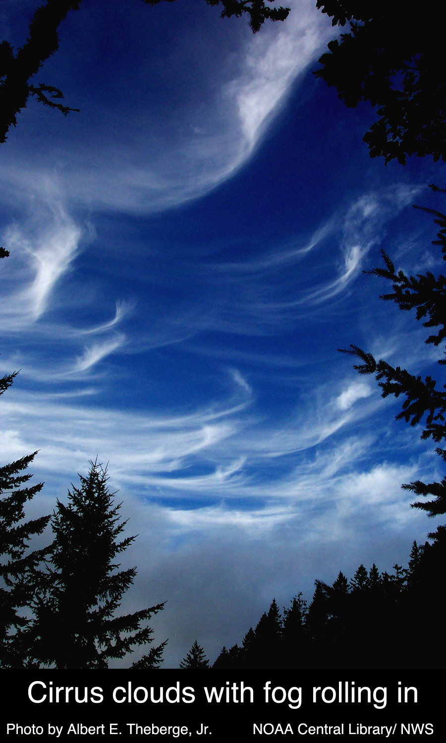
Clouds
Cirrus
Clouds formed at high elevations; wispy clouds usually consisting of ice crystals that signal fair weather or may also signal an approaching warm front.
MENU

Slide 6
Clouds
Combinations of those shapes can be used with nimbus, which means “rain”, for example, cumulonimbus or nimbostratus.
A cumulonimbus cloud, also called a thunderhead, is often part of thunderstorm conditions that may accompany a cold front.
The prefix alto- may also be used to indicate medium-level clouds formed at about 2-6 kilometers up into the atmosphere, for example, altocumulus or altostratus.
Clouds that form when condensation occurs at or near the ground are called fog.
MENU

Slide 7
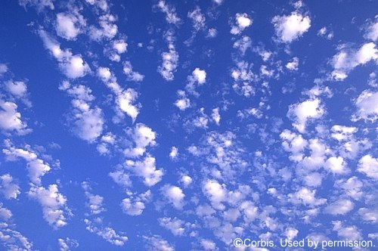
Cirro-cumulus clouds
MENU

Slide 8
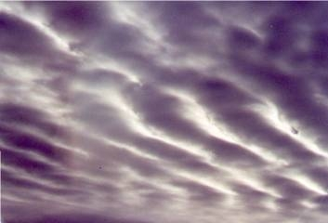
Alto-stratus Clouds
MENU

Slide 9
Alto-cumulus clouds
MENU

Slide 10
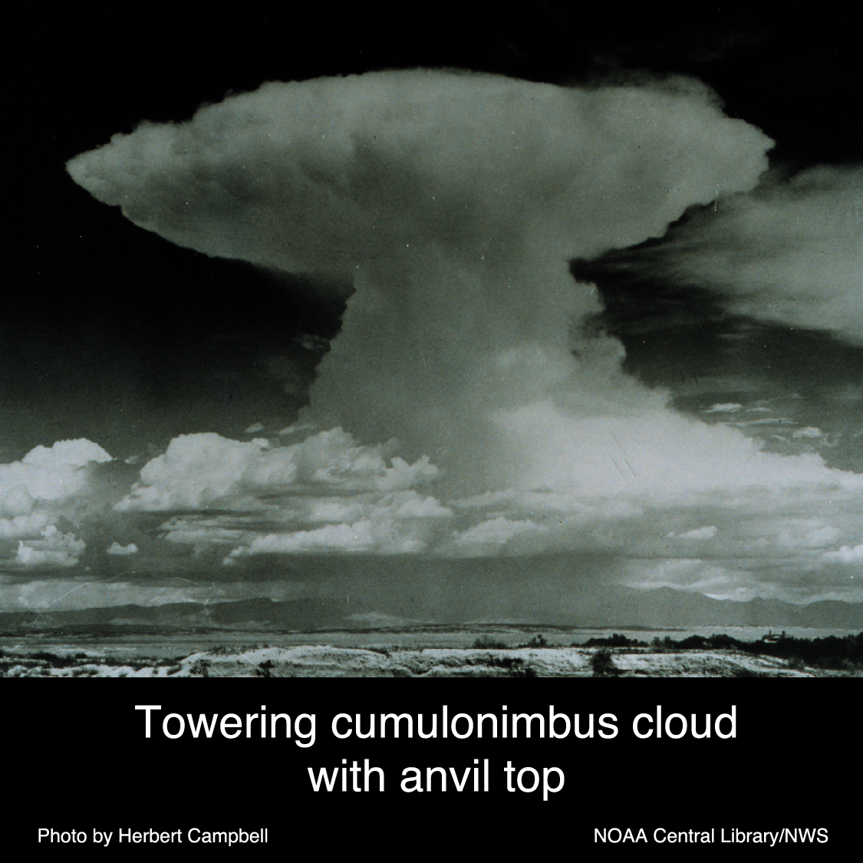
Cumulo-nimbus
Clouds
aka:
Thunderheads
MENU

Slide 11
Nimbo-stratus clouds
MENU

Slide 12
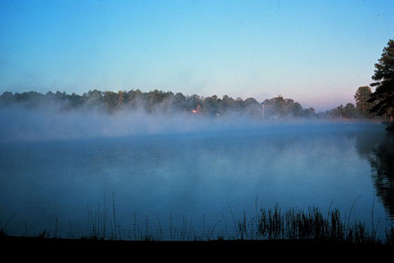
Fog
MENU

Slide 13
MENU

Slide 14
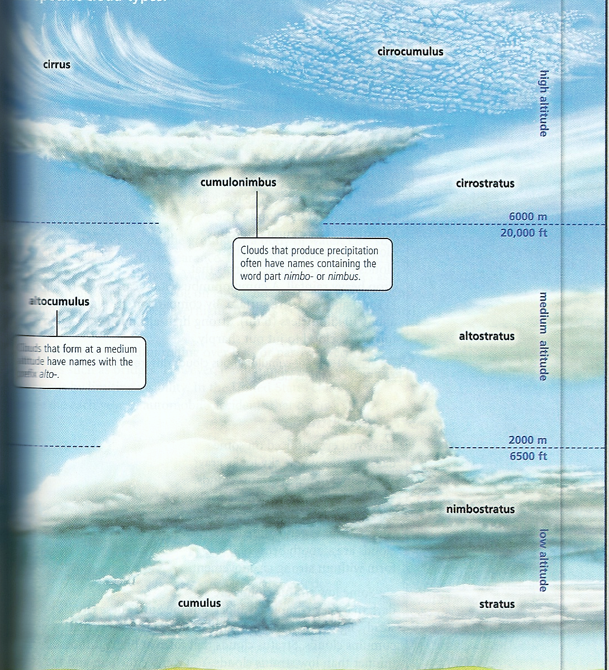
Fog
MENU

Slide 15
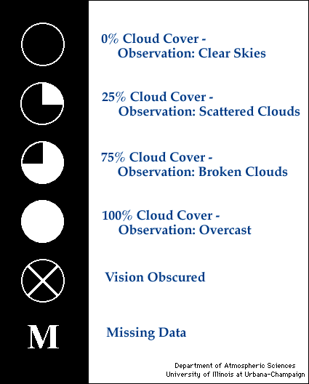
Cloud Cover Symbols
You will often see the circles drawn on a weather map
MENU

